Slide 1

Flash memories
Based on:
Roberto Bez et al., ST Microelectronics
Proceedings of the IEEE, Vol. 91 no. 4, April 2003.

Slide 2

Contents
Non-volatile memories
what are NVM
method of operation
EPROM, EEPROM, and Flash
Reliability concerns
retention
endurance
Scaling

Slide 3
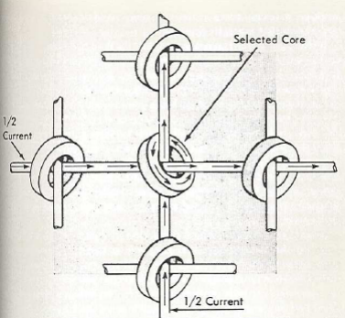
Non-Volatile Memories
A non-volatile memory is a memory that can hold its information without the need for an external voltage supply. The data can be electrically cleared and rewritten
Examples:
Magnetic Core
Hard-disk
OTP: one-time programmable (diodes/fuses)
EPROM: electrically programmable ROM
EEPROM: electrically erasable and programmable ROM
Flash

Slide 4
IC memory classification
Volatile memories
Lose data when power down
Non-volatile memories
Keep data without power supply
SRAM
DRAM
ROM
PROM
EPROM
EEPROM
Stand-alone versus
embedded memories
This lecture: stand-alone
FLASH EEPROM

Slide 5
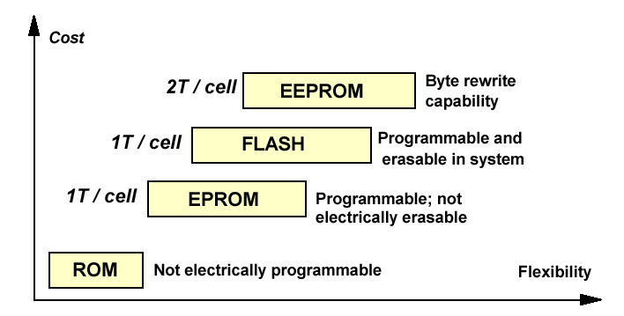
Non-volatile memory comparison
Floating gate memories
Comparison: later today

Slide 6
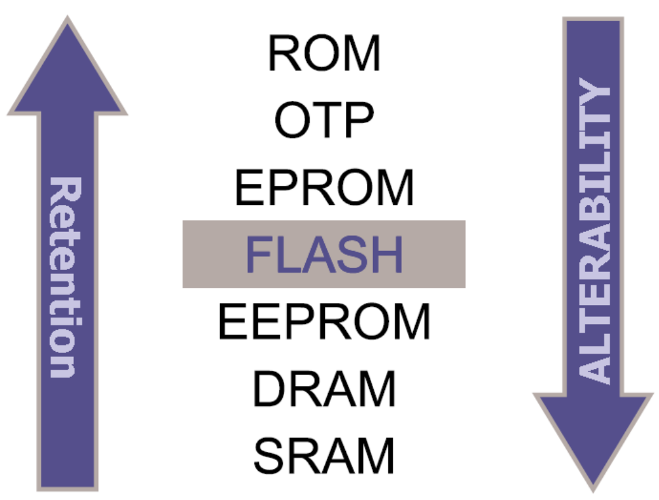
Retention vs. alterability

Slide 7
How does a Flash memory cell work?
…How does a MOS transistor work?
…What is a semiconductor?
See: college Halfgeleiderdevices!! ☺

Slide 8
Semiconductor essentials: properties
Metallic conductor:
typically 1 or 2 freely moving electrons per atom
Semiconductor:
typically 1 freely moving electron per 10⁹-10¹⁷ atoms

Slide 9
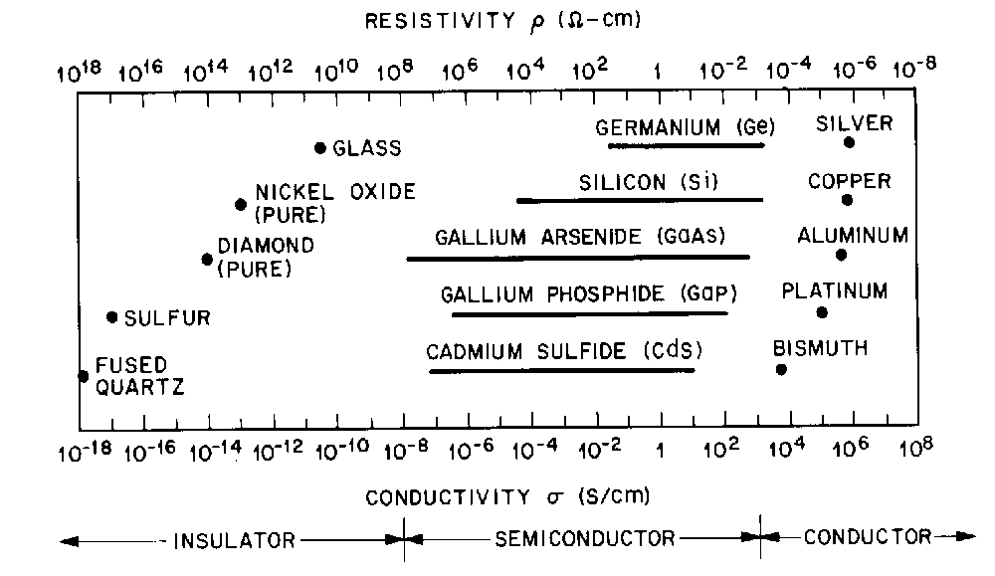
Semiconductor essentials - resistivity
Notes:
This figure, from S. M. Sze’s book, shows the conductivity of insulators (left), semiconductors (middle), and conductors (right). The graph covers 26 orders of magnitude. By modification of the material, we can adjust the conductivity of semiconductors over several orders of magnitude.

Slide 10
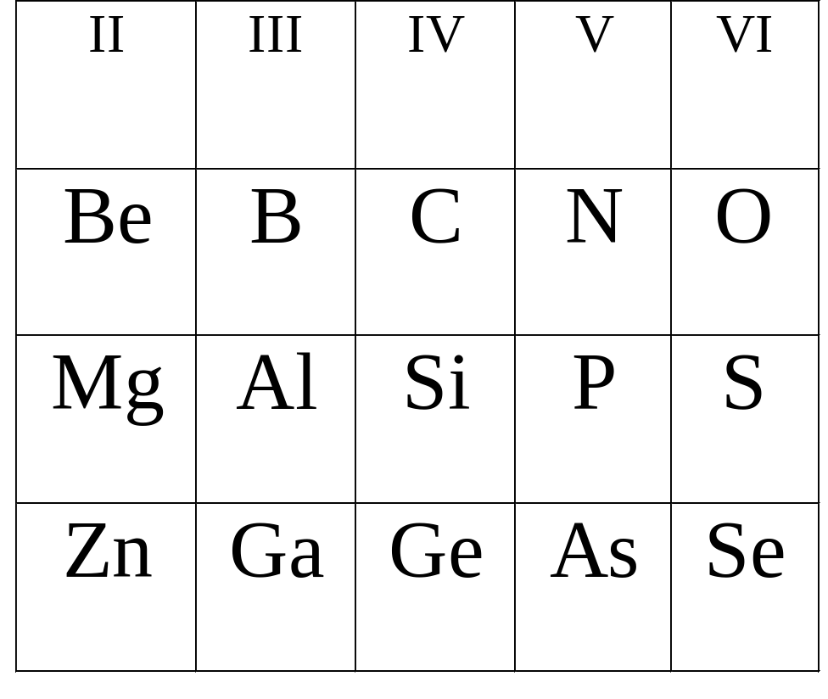
Semiconductors in the periodic table
Elemental semiconductors:
C, Si, Ge (all group IV)
Compound semiconductors:
III-V: GaAs, GaN…
II-VI: ZnO, ZnS,…
Group-III and group-V
atoms are “dopants”

Slide 11
Semiconductor essentials: impurities
Small impurities can dramatically change conductivity:
  slight phosphorous contamination in silicon gives many extra free electrons in the material (one per P atom!)
  slight aluminum contamination gives many extra holes (one per Al atom)
P
Al

Slide 12
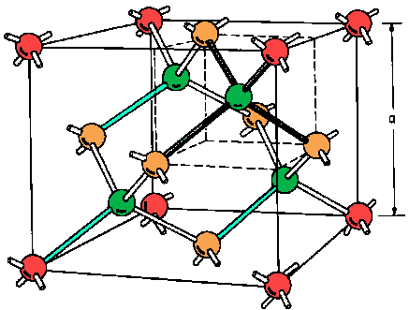
(silicon lattice is of course 3D!)
Notes:
This figure is a bit out of proportion (for reasons of clarity). A silicon atom has an atomic radius of 0.117 nm, or 0.234 nm diameter, while the lattice constant a of the silicon lattice is 0.5 nm. “Heavy” impurities like As and In have an atomic radius only slightly larger than Si, being 0.121 and 0.166 nm respectively. At a glance there seems to be enough space for an impurity to take the place of a Si atom. (The radius of a free atom is larger than the atoms in the lattice.)

Slide 13
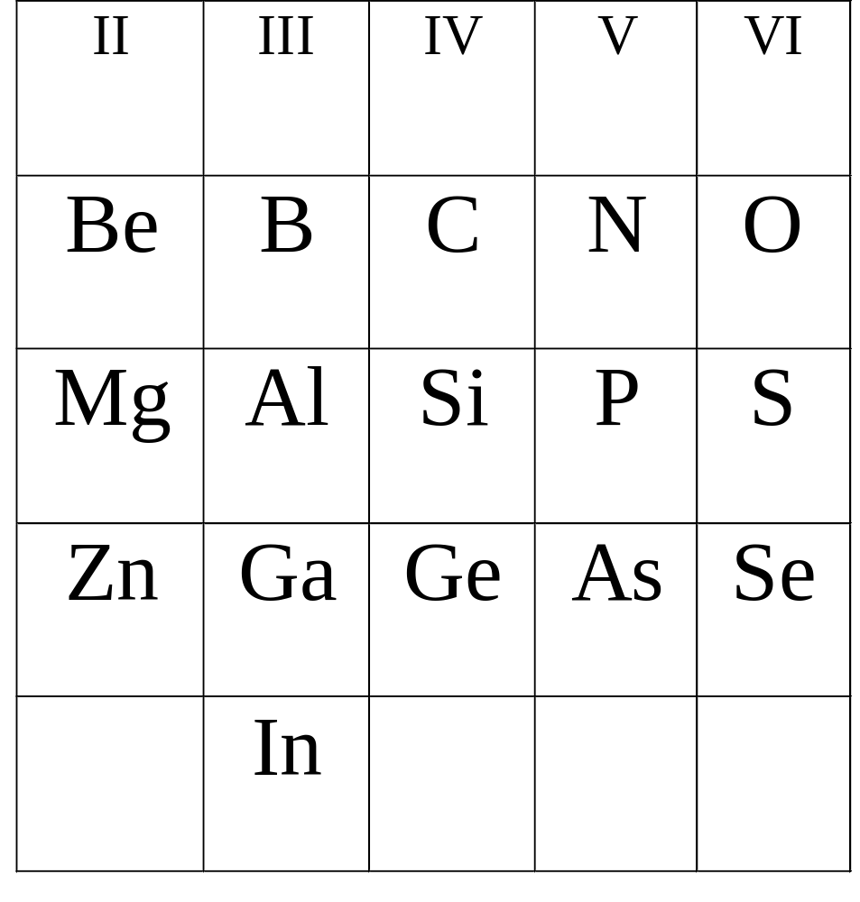
Silicon dopants
Boron most widely used
as p-type dopant;
Phosphorous and arsenic
both used widely as n-type
dopant

Slide 14
Semiconductor essentials: n and p type
n-type doped semiconductor
e.g. silicon with phosphorus impurity
electrons determine conductivity
p-type doped semiconductor
e.g. silicon with Al impurity
holes determine conductivity
p-n junction:
current can only flow one way!
Semiconductor diode

Slide 15
The field effect
+ + + + + + + +
accumulation
- - - -
depletion
- - - - - - - - - -
inversion

Slide 16
The MOS transistor
- - - - - - - - - -
- - - - - - - - - -
SOURCE
DRAIN

Slide 17
A MOS transistor layout
source
gate
drain
source
gate
drain
(cross section)
(top view)
(cross section)

Slide 18
NMOS and PMOS transistors
Free electron
Free hole
NMOS
PMOS
+ + +
- - -
Conducts at +V_{GB}
Conducts at -V_{GB}
NMOS + PMOS = CMOS

Slide 19
MOSFET operation (very basic)
V_{fb}
V_{T}
C
V
accumulation
depletion
inversion

Slide 20
Current through the MOS transistor
inversion
Channel charge: Q ~ (V_{gs} – V_{T})
Channel current: I ~ (V_{gs} – V_{T})
MOS transistor - simplistic
MOS transistor - real
I
I
V_{gs}
V_{gs}
V_{T}
V_{T}

Slide 21
Concept of the floating-gate memory cell
MOS transistor: 1 fixed threshold voltage
Flash memory cell: V_{T} can be changed by program/erase
MOS transistor
Floating gate transistor
I_{d}
I_{d}
programming
erasing
V_{gs}
V_{gs}
V_{T}

Slide 22
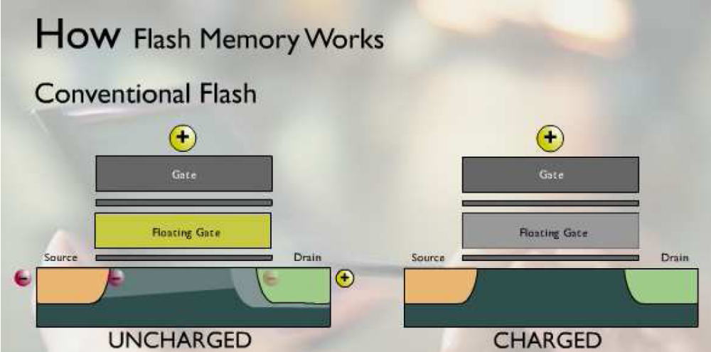
Floating gate animation
http://www3pub.amd.com/products/nvd/mirrorbit/flash.htm

Slide 23
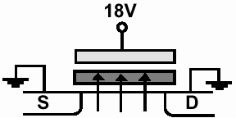
Floating gate transistor: principle
V_{T} is shifted by injecting electrons into the floating gate;
It is shifted back by removing these electrons again.
CMOS compatible technology!
Control gate
Floating gate

Slide 24
Channel charge in floating gate transistors
unprogrammed
programmed
Control gate
Control gate
Floating gate
Floating gate
silicon
To obtain the same channel charge, the programmed gate needs a higher control-gate voltage than the unprogrammed gate

Slide 25
Logic “0” and “1”
Reading a bit means:
1. Apply V_{read} on the control gate
2. Measure drain current I_{d} of the floating-gate transistor
When cells are placed in a matrix:
I_{d}
ΔV_{T} = -Q/C_{pp}
drain lines
V_{gs}
V_{read}
Control
gate
lines
“1” → I_{read} >> 0
“0” → I_{read} = 0

Slide 26
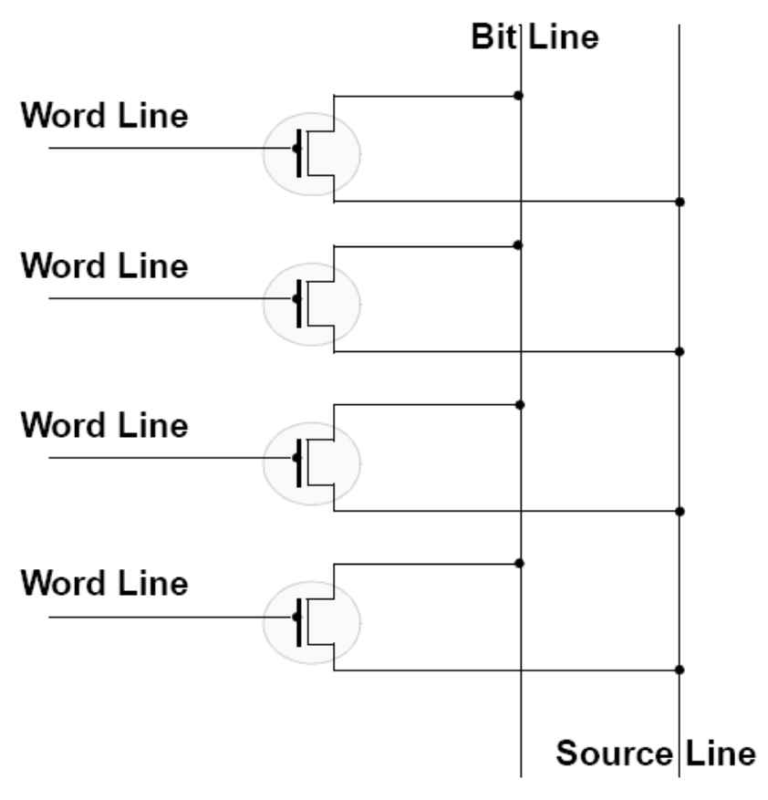
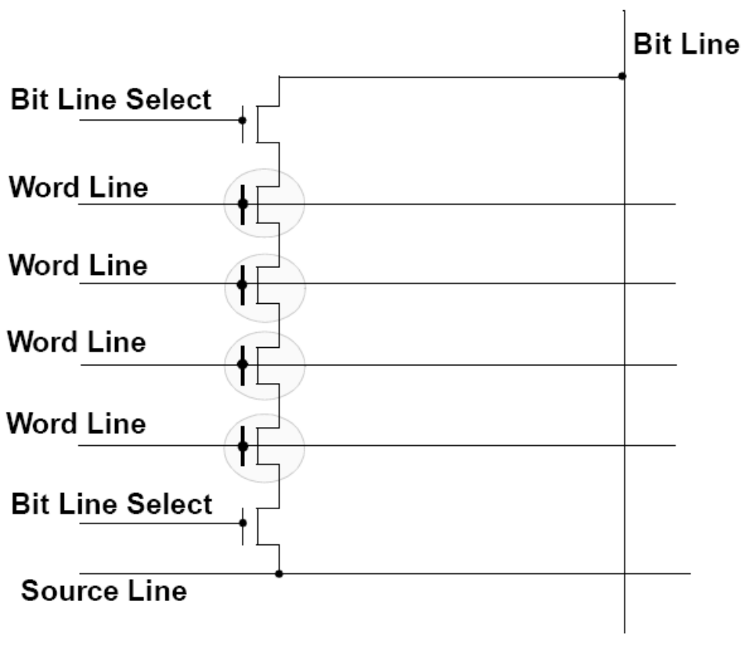
NOR or NAND addressing
‘Word’ = control gate; ‘bit’ = drain
NOR
NAND
less contacts → more compact

Slide 27
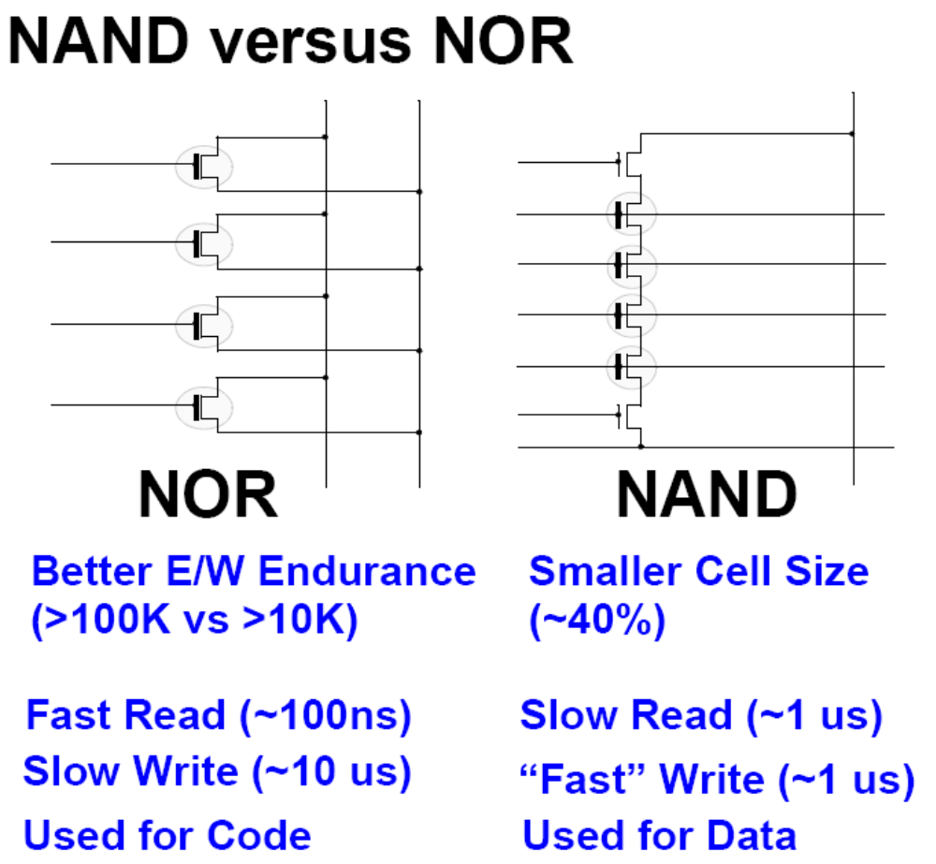
NAND versus NOR
10x better endurance
Fast read (~100 ns)
Slow write (~10 μs)
Used for Code
Smaller cell size
Slow read (~1 μs)
Faster write (~1 μs)
Used for Data

Slide 28
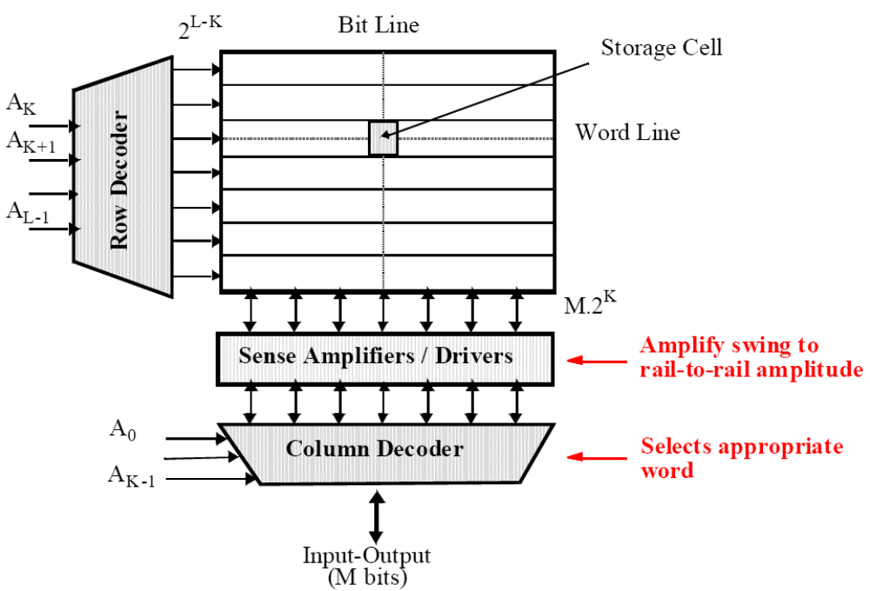
Array addressing

Slide 29
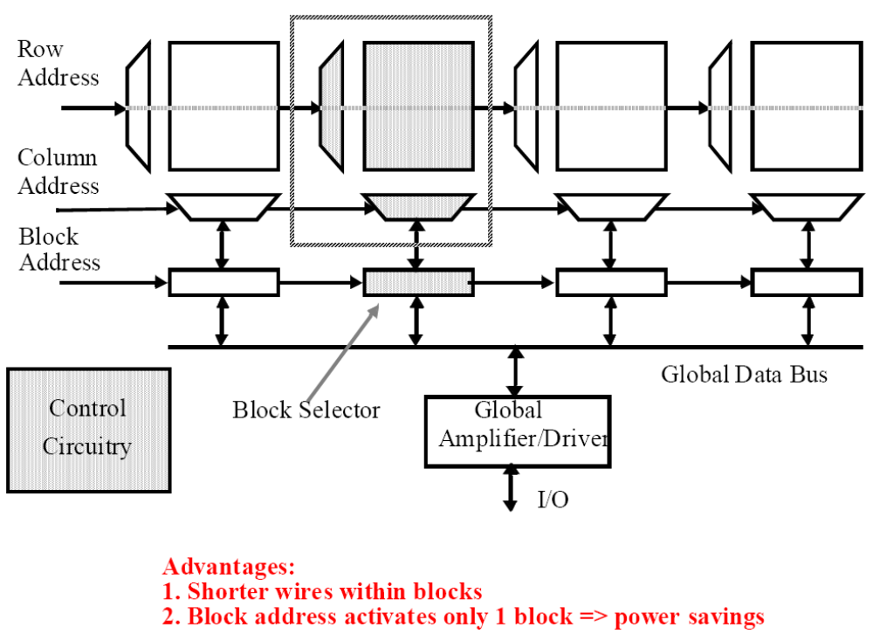
Larger memories: cut into blocks

Slide 30
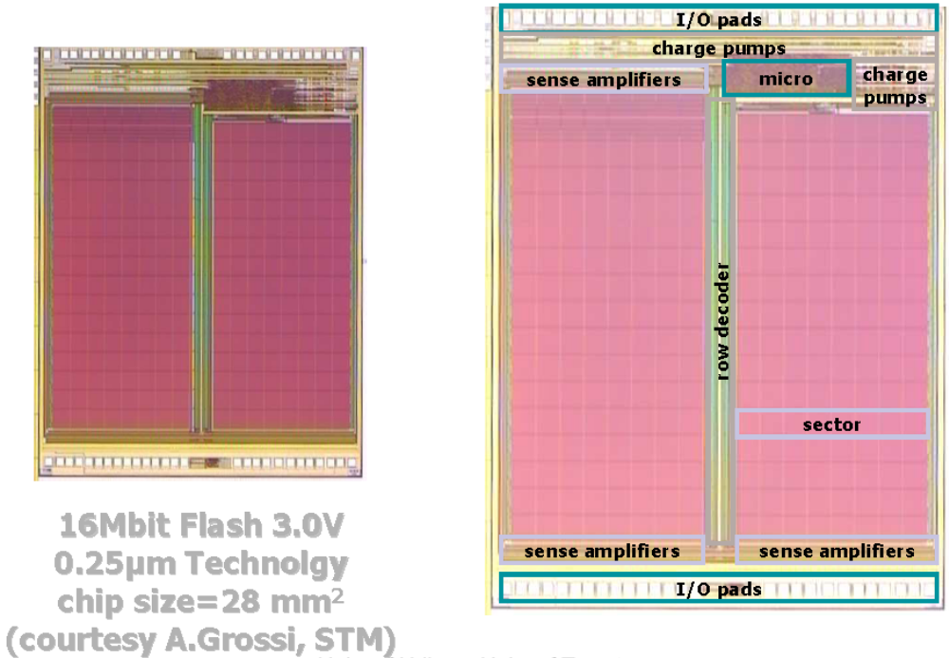

Slide 31
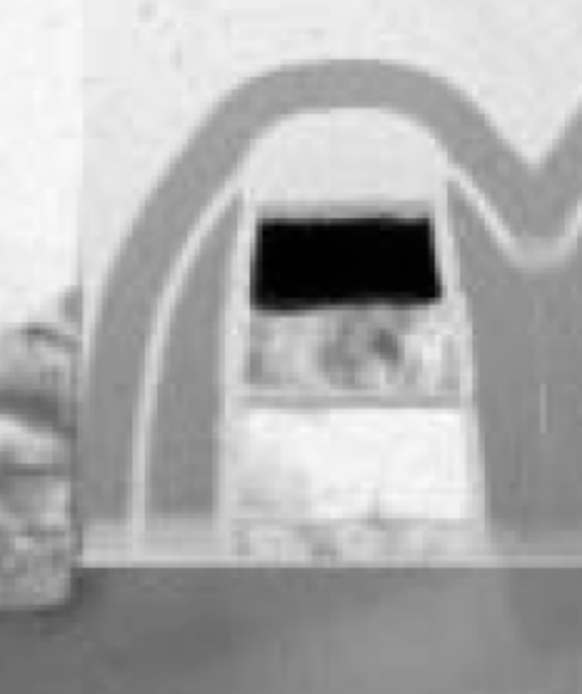
Programming and erasing the floating gate
Control gate
Floating gate
Control gate
SiO₂
Si₃N₄
Floating gate
Polysilicon

Slide 32
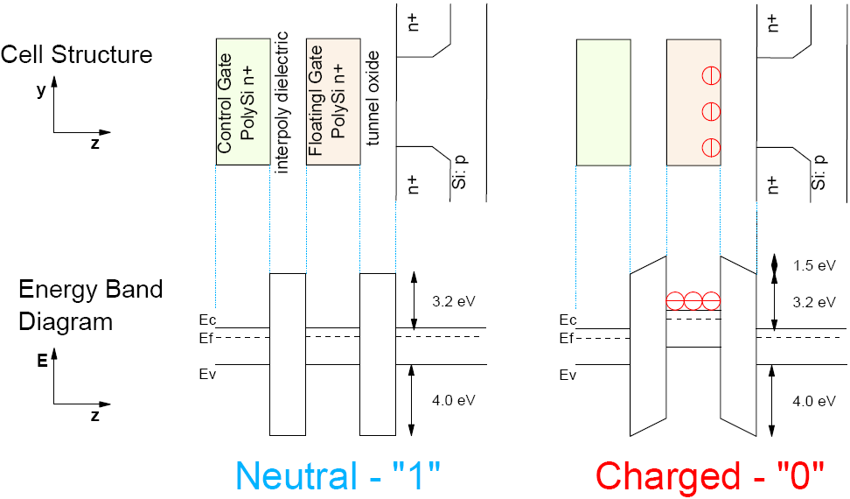
Band diagram (over-simplified!)

Slide 33
Program/erase of a floating gate transistor
Floating gate is surrounded by insulating material.
How to drive charge in and out of it?
Injection/ejection mechanisms:
  Fowler-Nordheim tunneling (FN)
  Channel Hot Electron Injection (CHE)
  Irradiation (most common: UV, for EPROMs)

Slide 34
Conduction through SiO₂
Dominant current components:
Intrinsic quantummechanical conduction
  Fowler-Nordheim tunneling
  Direct Tunneling
Defect-related:
  Trap-assisted tunneling
  (via a molecular defect)
  Current through large defects
  (e.g. pinholes)
Intrinsic current is defined by geometry & materials
Defect-related current can be suppressed by engineering
V_{G}
V_{D}
V_{B}

Slide 35
Gate oxide conduction - example
4 nm oxide
10
-3
10
-4
Hard
10
-5
breakdown
10
-6
Soft
breakdown
(A)
10
-7
|
10
-8
G
I
|
10
-9
10
-10
10
-11
SILC
10
-12
10
-13
Unstressed oxide
10
-14
-2
-1
0
1
2
3
4
5
V
G
(V)

Slide 36
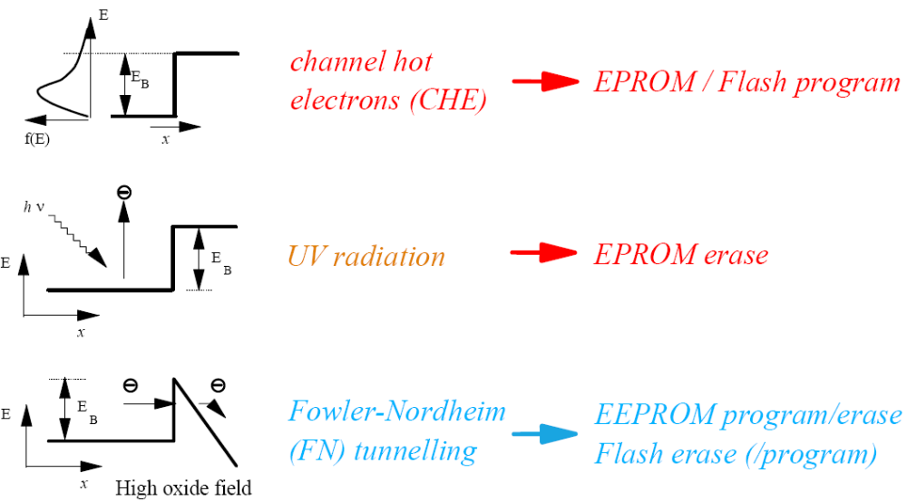
Program/erase mechanisms

Slide 37
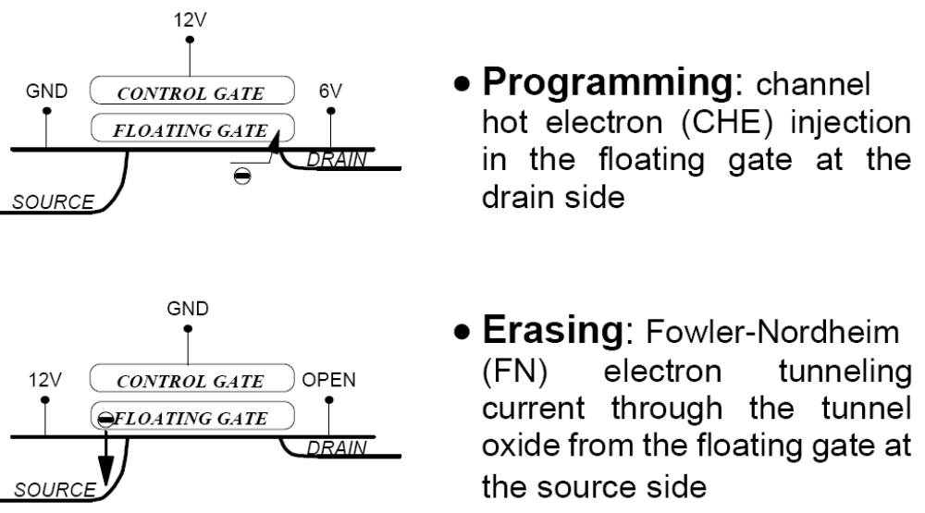
Flash program and erase methods

Slide 38
CHE: Hot electron programming
Field → kinetic energy → overcome the barrier
Hot holes
Hot electrons
Hole substrate current
Pinch-off → high electric fields near drain → hot carrier injection through SiO₂
Note: < 1% of the electrons will reach the floating gate → power-inefficient

Slide 39
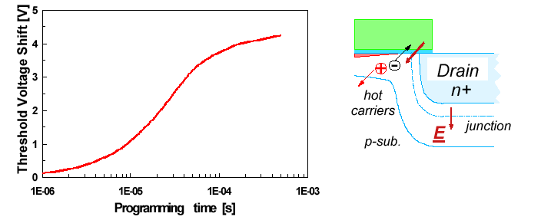
Programming: Channel Hot Electron Injection

Slide 40
CHE: properties
Works only to create a positive V_{T} shift
High power consumption: ~300 µA/cell
(most electrons get to the drain: lost effort)
Moderate programming voltages
Risky: hot carriers can damage materials
  May lead to fixed charge, interface traps, bulk traps
  Results in degradation of the cell (see later)

Slide 41
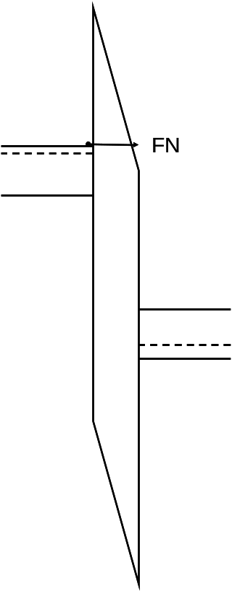
Fowler-Nordheim tunneling
Uniform tunneling through entire dielectric is possible
V_{T}-shift can be positive as well as negative
  Can be used for program and erase
Requires high voltage and high capacitances
Little power needed (~10 nA/cell)
Risks of this technique:
  Charge trapping in oxide
  Stress-induced leakage current
  Defect-related oxide breakdown

Slide 42
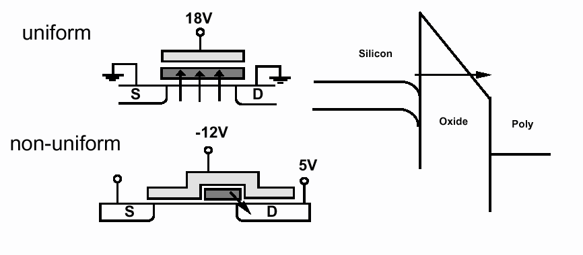
Uniform or drain-side FN tunneling
Non-uniform: only for erasing; less demanding for the dielectric

Slide 43
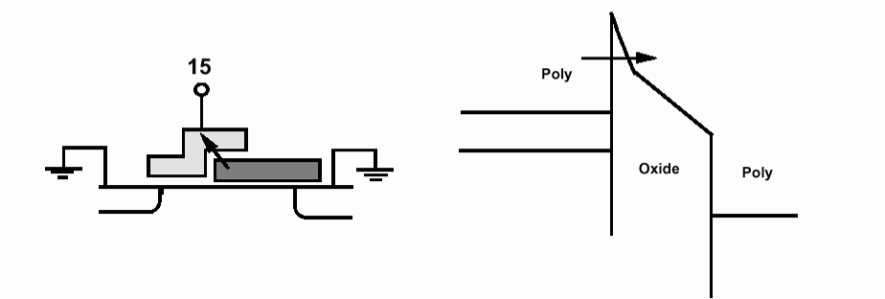
Alternative: tunnel through interpoly oxide
(erasing, combined with CHE program)
Less demanding for the tunnel oxide
Therefore less SILC and better retention
More demanding for interpoly oxide
Uses high voltage and low power

Slide 44
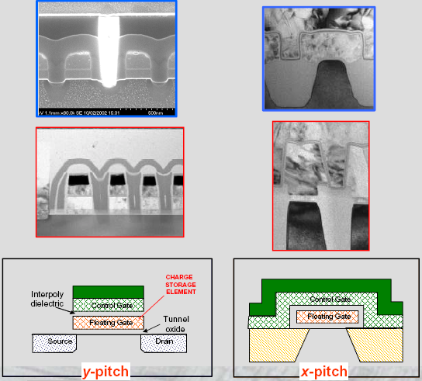
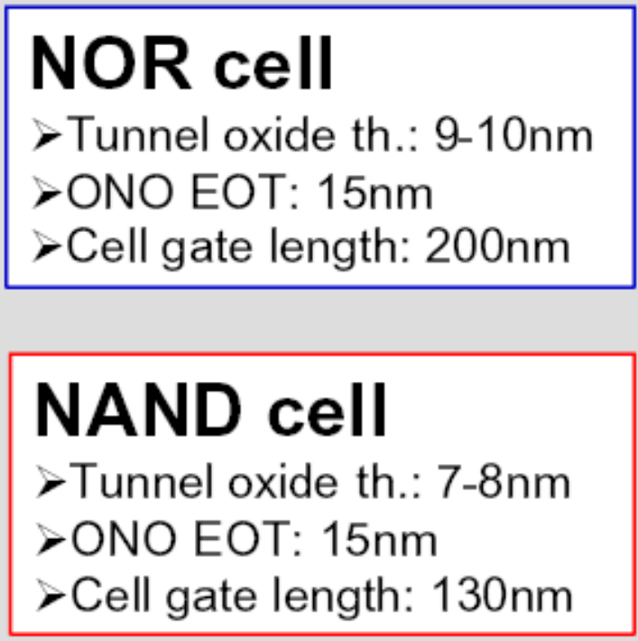
NOR and NAND flash technology

Slide 45
BREAK

Slide 46
Flash reliability issues and scaling
Flash reliability concerns:
The regular reliability concerns of CMOS
  Oxide breakdown
  Interconnect problems (electromigration)
  …
Specific for Flash:
  Retention
  Endurance
Scaling:
Can we make the flash cell more compact?
  Dominant problem: scaling the dielectrics

Slide 47
Reliability issues
Specific problems in non-volatile memories:
Fast programming and erasing (~10⁻⁶ s) is done by
controlled tunnelling, leads to oxide degradation (trapping)
Functional requirements
no charge leaking in stand by situation
  (up to 3 . 10⁸ s)
distinguish “0” and “1” even after intensive use
In a 10 MB memory, should every single bit be OK?
Trade-off: reliability ↔ error detection & correction

Slide 48
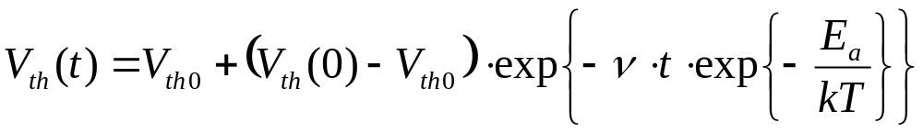
Retention (herinneringsvermogen)
Ability to retain valid data for a prolonged period of time under storage conditions (non-volatile).
Single Cell:
time before change of 0.1% change in stored data while not under electrical stress➔Intrinsic retention
Array of Cells:
retention of the worst cell in the array before and after cycling➔defect related = Extrinsic retention
“Alzheimer’s Law”:

Slide 49
Retention
Charge loss due to: de-trapping of electrons/holes
oxide defects
mobile ions
contamination
Accelerated test at high T → E_{a} of the dominant process
Virgin devices reveal insulating properties of dielectric
Stressed devices (after program/erase cycles): retention ↓
High T works as bake-out
Major retention hazard: stress-induced leakage current

Slide 50
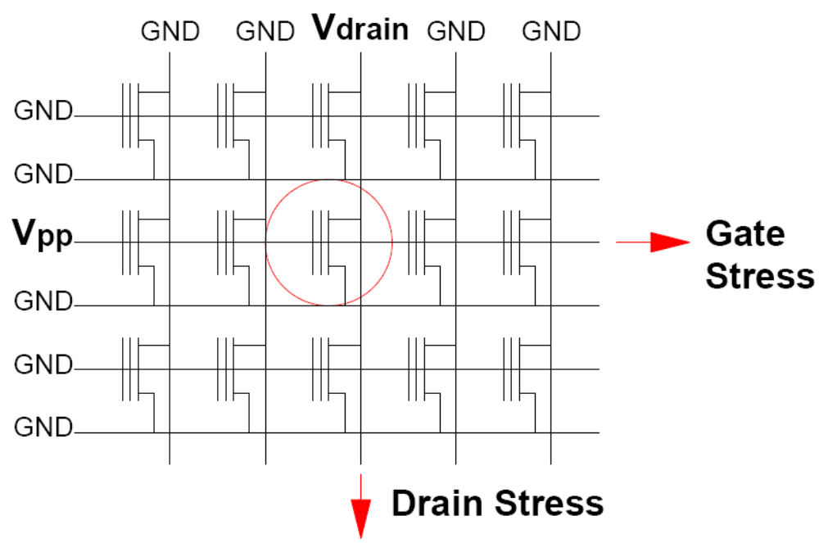
Retention
Problem: not a single cell, but embedded in a matrix
During programming of one cell, all neighbours are also exposed to the same high programming voltage
FN-tunnelling can then induce charge loss
(leaking away of information/data)
cell floating gate capacitance ~1fF
loss of 1fQ causes V_{T} shift of 1V
Charge loss rate for 10 year retention:
Less than 5 electrons per day!!

Slide 51
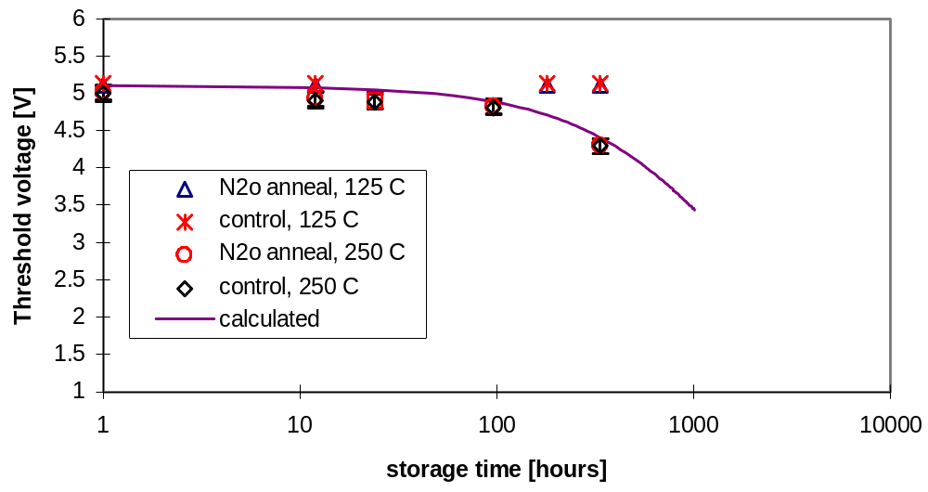
Example of retention study
At 250 ºC decrease starts after 10h
Extrapolation leads to conclusion that the lifetime at room temperature >10 years
…using which model????

Slide 52
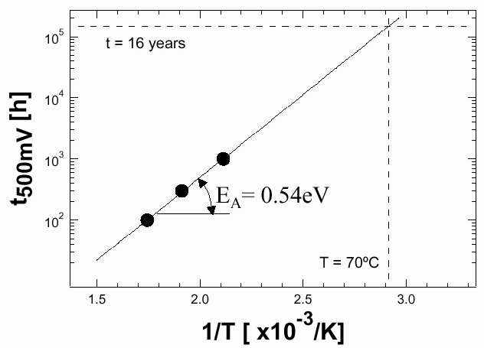
A more thorough study
Test at different temperatures
Determine activation energy (assuming Arrhenius)
(Identify mechanism)
Time until V_{T} has shifted by 500 mV

Slide 53
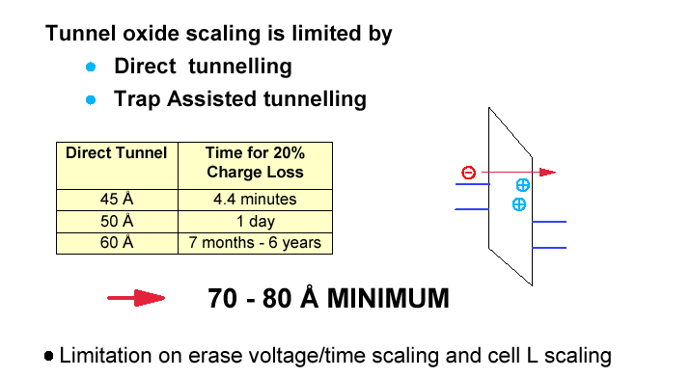
Data retention prohibits tunnel oxide scaling
Tunnel oxide thickness | Time for 20% charge loss
4.5 nm | 4.4 minutes
5 nm | 1 day
6 nm | ½ - 6 years
7-8 nm is the bare minimum

Slide 54
Retention: summary
Retention = the ability to hold on to the charge
Loss > 5 electrons per day is killing in the long run
Mostly limited by defects in the tunnel oxide
Retention can be compromised with error correction
For thin oxides < 7 nm, the retention of Flash is intrinsically insufficient
To test retention, measure at different T and field

Slide 55
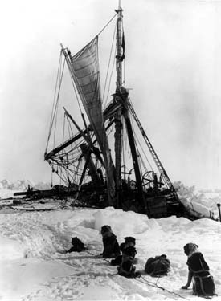
Endurance (uithoudingsvermogen)
Ability to perform even after a large number of program/erase cycles
Showstoppers:
Oxide breakdown
Loss of memory window
Shift in operating margin

Slide 56
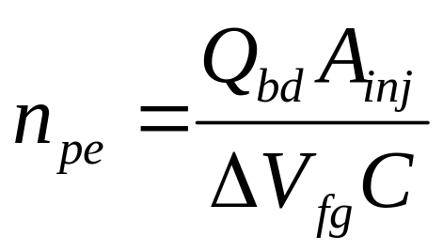
Endurance: oxide breakdown
A dielectric will break down when a certain amount of charge has crossed it: this amount is Q_{BD}.
Typical for good SiO₂ material: Q_{BD} = 10 C/cm².
Simple relation:
n_{pe} the number of program/erase cycles until breakdown
ΔV_{fg} the shift between the “0” and “1” state
Good engineering gives a grip on Q_{BD} → then, no problem

Slide 57
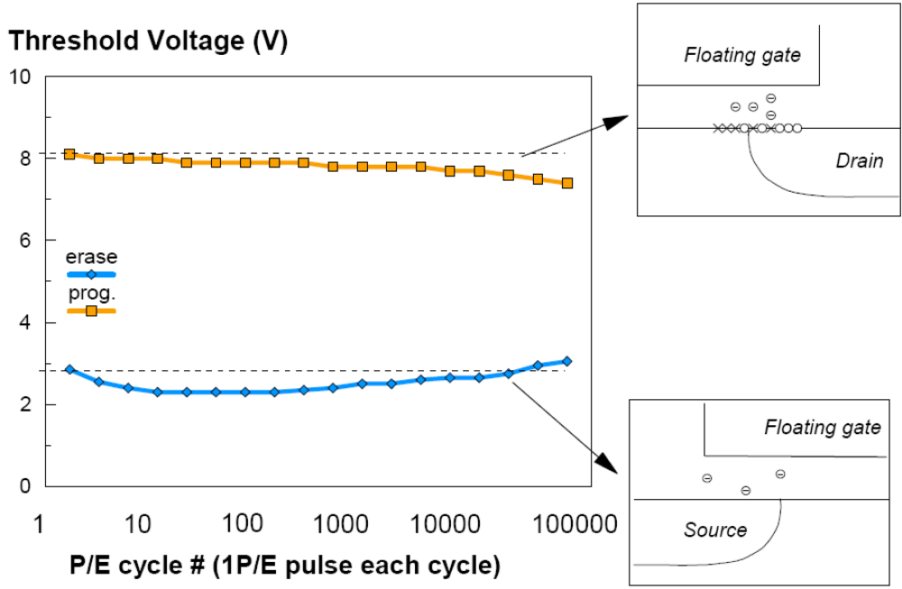
Endurance: window closing
Fixed charges appear
in the tunnel oxide after
program/erase cycles
Program/erase cycles

Slide 58
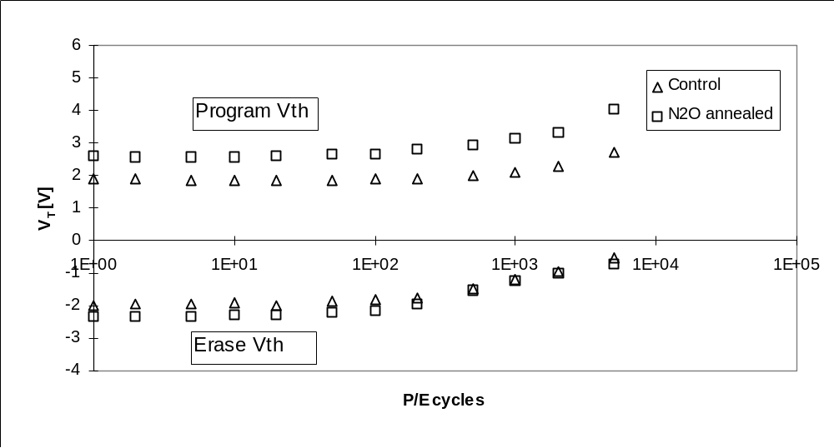
Endurance: shift in operating margin
V_{T,erase} increases due to electron trapping in interpoly-dielectric (normal)
Simultaneous V_{T,program} increases indicates charge trapping in the gate oxide
Program/erase cycles

Slide 59
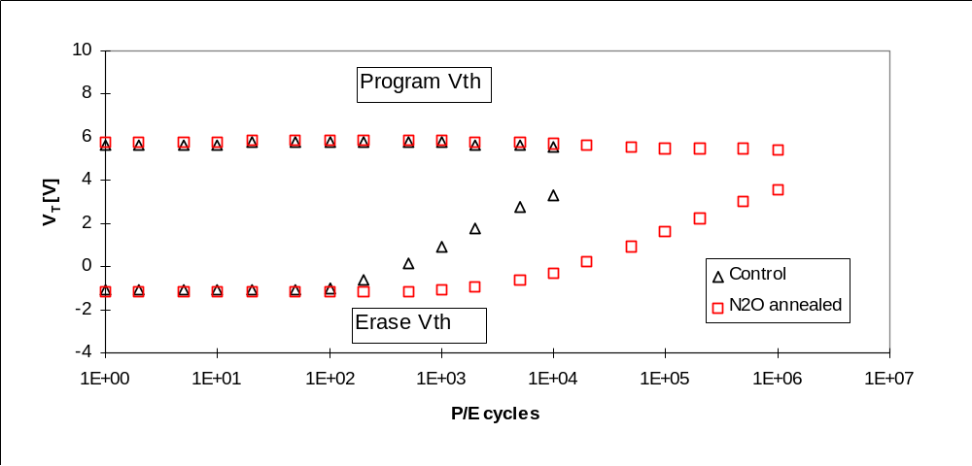
Endurance: example
A simple modification of the tunnel dielectric →
Window closure is retarded with more than an order of magnitude
Program/erase cycles

Slide 60
Endurance: mechanism vs. pragmatism
High electric fields inside the cell; and high currents
Therefore wearout occurs: conductors become less conductive, dielectrics become less isolating.
Nature will drive the cell back towards its “natural V_{T}”.
Knowing how long a product will last, is sufficient! So:
Find out which parameters are relevant (voltage, temp.)
Determine the acceleration mechanisms
Test if all cells follow the same wearout behaviour

Slide 61
Endurance in a memory array
One cell is addressed for programming, but:
Entire row endures gate stress;
Entire column endures drain stress.
In large arrays, this is the bottleneck for endurance.

Slide 62
Flash scaling
What is the plan
What is the problem
How to continue
The ITRS roadmap is found on http://www.itrs.net/Links/2007ITRS/Home2007.htm

Slide 63
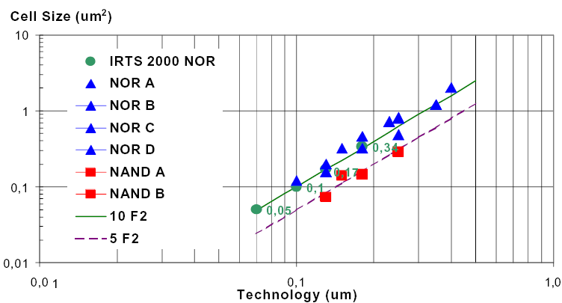
Flash scaling: went fine so far!
1990-2000: factor 30 decreased
time

Slide 64
Traditional scaling
The basic cell structure has remained unchanged
Cell area was scaled down by:
Scaling of W and L
Scaling of the passive elements and the periphery
Compensate oxide non-scaling by more aggressive scaling of the other elements in the device
(See the Master course IC-technology for further details!)

Slide 65
ITRS 2007: Flash ambitions
 | 2007 | 2008 | 2009 | 2010 | 2011 | 2012 | 2013
NAND half pitch (nm) | 51 | 45 | 40 | 36 | 32 | 28 | 25
What’s new? |  |  | Lower W/E voltage |  |  | High-k
# bits per cell | 2 | 2 | 3 | 4 | 4 | 4 | 4
Dielectric scaling is no longer possible
Still pretty ambitious plans: how to achieve so many bits/μm²?

Slide 66
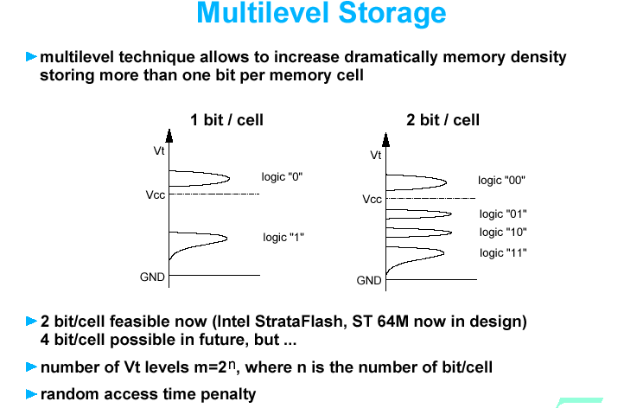
Trick 1: multilevel storage
Mirrorbit is an example of 2 bits/cell

Slide 67
Multilevel storage: issues
Less margin between the levels, so:
More accurate read (impact on access time)
More accurate program (impact on program speed)
Better data retention (higher reliability demands)
Higher word-line voltages are necessary to open the window for more levels
Program and read disturbs
Same reliability issues as for 1 bit/cell but with less margin
Error correction required

Slide 68
Trick 2: high-k layer as interpoly dielectric
Higher capacitance between control gate and floating gate without leakage
Issue: no suitable high-k material has been identified…
Trick 3: virtual ground
A new way of addressing NOR-Flash memory cells
Avoids the bitline contacts within a memory array
Issues: disturb, loss of read margin

Slide 69
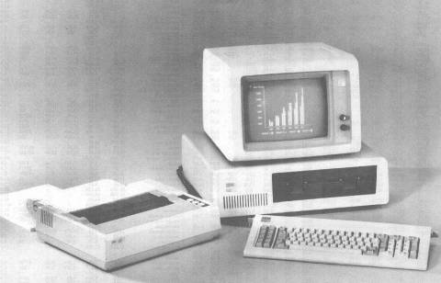
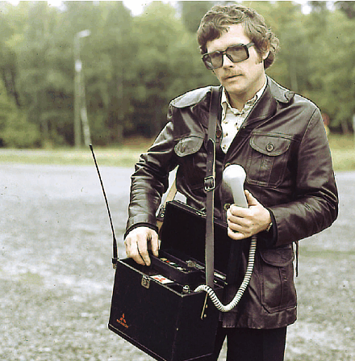
Trick 4: clever people
So far, IC technology benefited from smaller dimensions;
But much more progress was made by
breakthrough inventions!
Examples: ion implantation, Shallow Trench Isolation, silicides, strained silicon, atomic layer deposition
Without them:
Nu te koop bij
uw speciaalzaak!

Slide 70
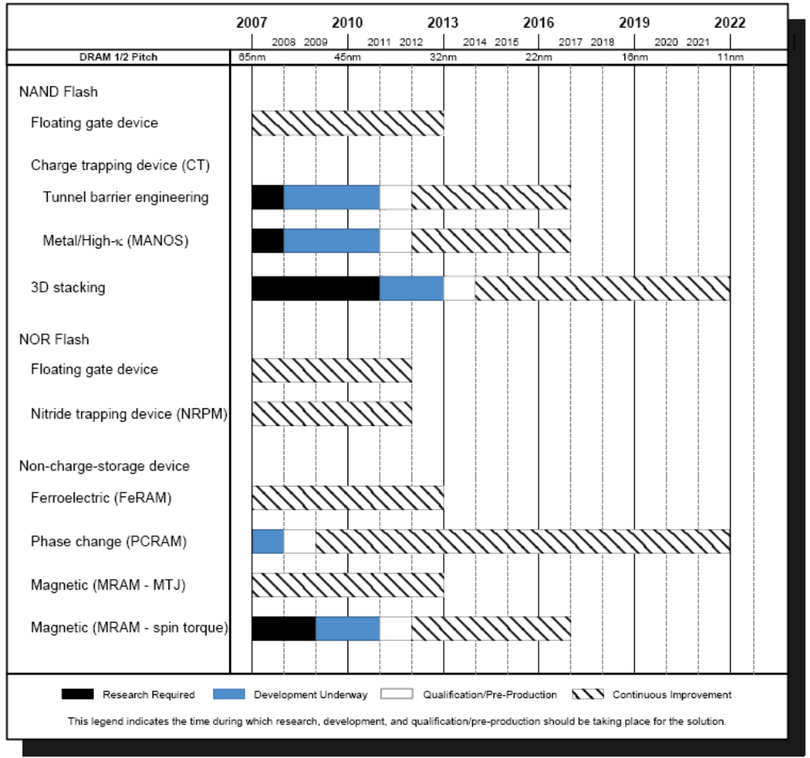
ITRS 2007: long-term vision on NVM

